Slide 1


SAP UX
Version 1.0, July 2015
Author Ross Hightower
Product SAP HANA Cloud Platform
Level Beginner
April 9, 2016
Focus
An overview of SAP UX Strategy
Public

Slide 2
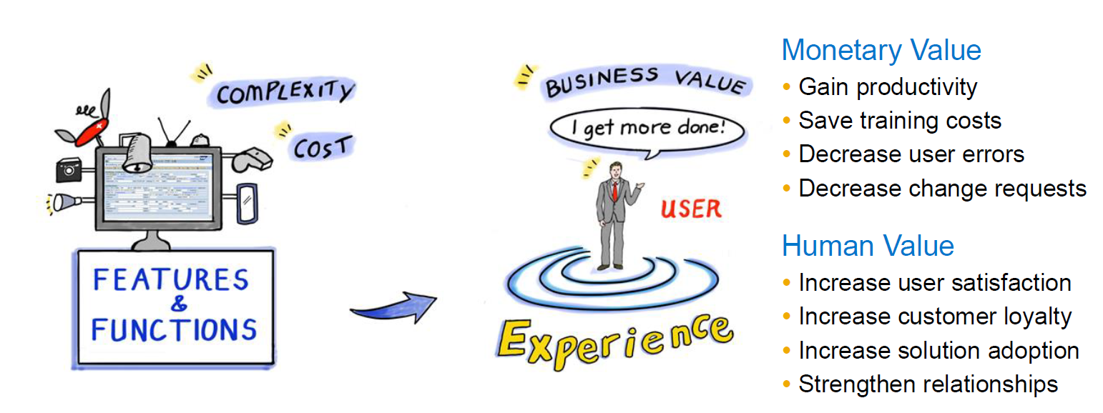
UX focus vs Features Focus

Slide 3
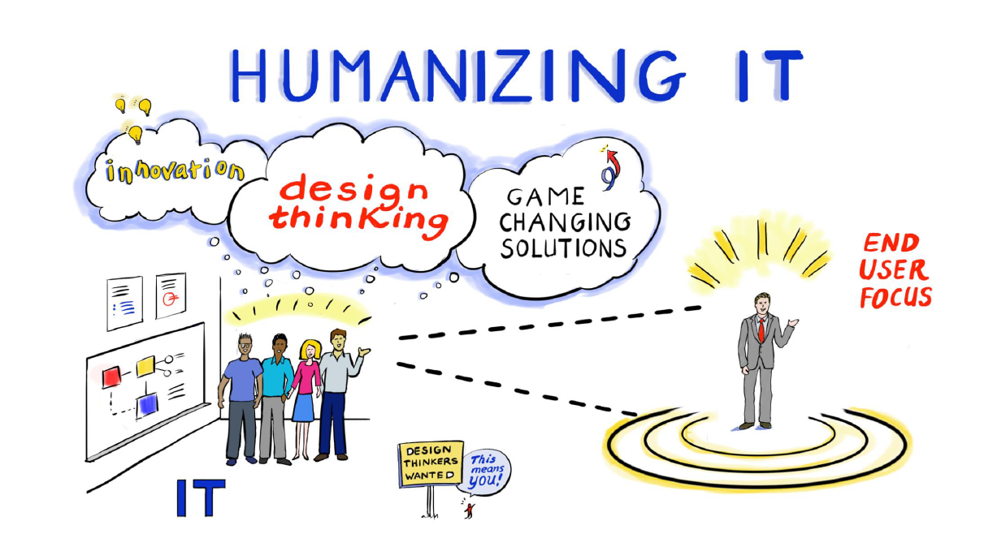
User eXperience Focuses on Human Needs

Slide 4
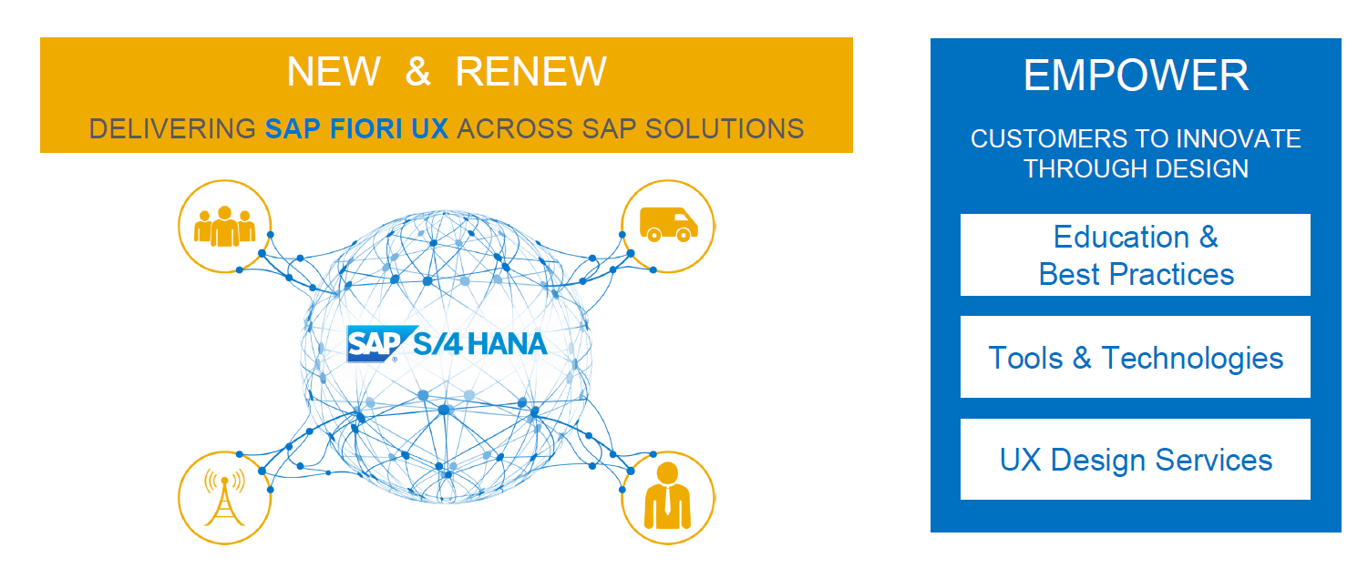
SAP UX Strategy

Slide 5
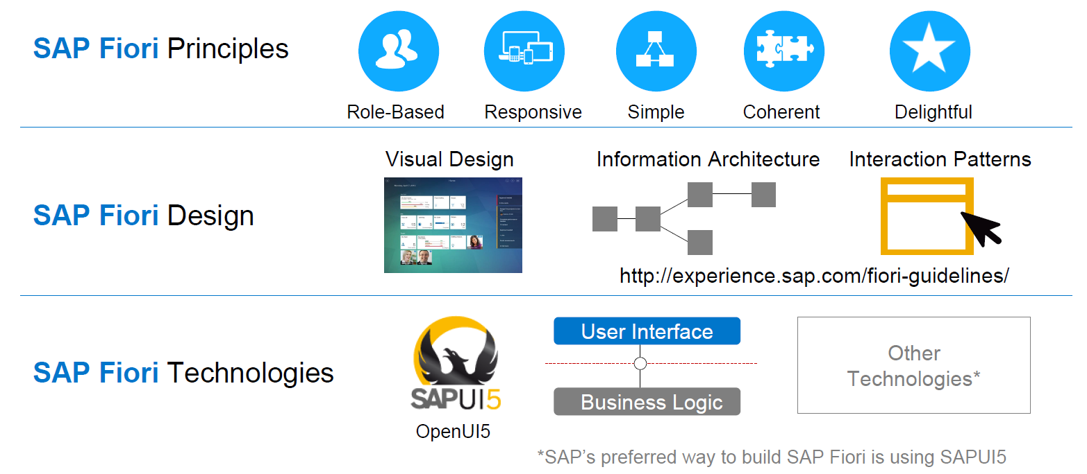
SAP Fiori
SAP Fiori Guidelines

Slide 6
Principles

Slide 7
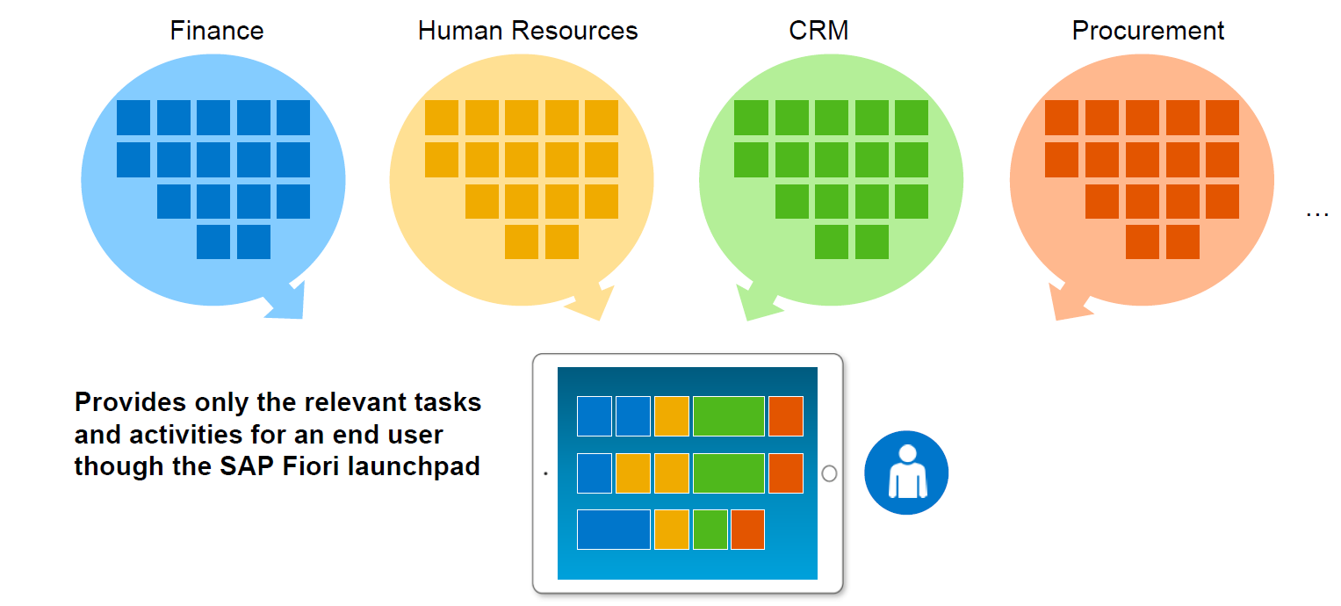
Principle: Role Based Applications

Slide 8
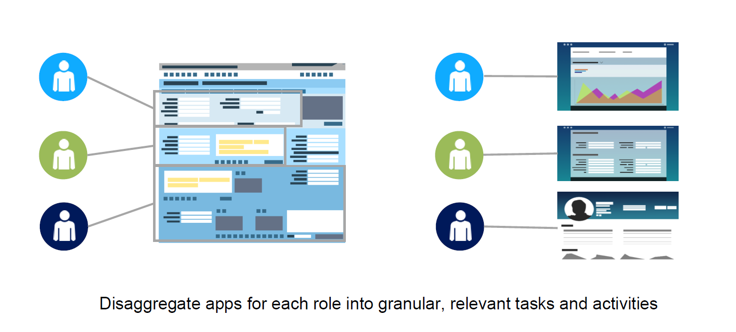
Principle: Disaggregate applications

Slide 9
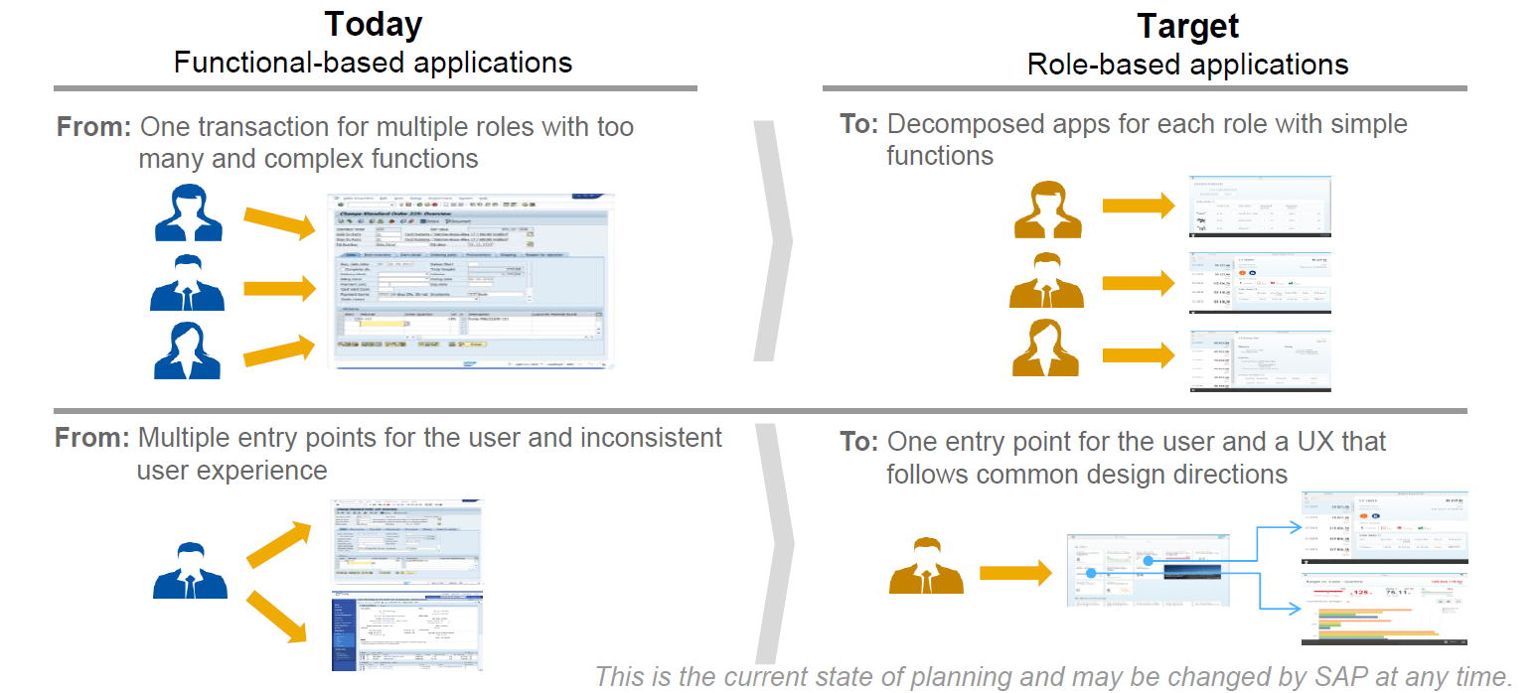
Principle: Consistent UX

Slide 10
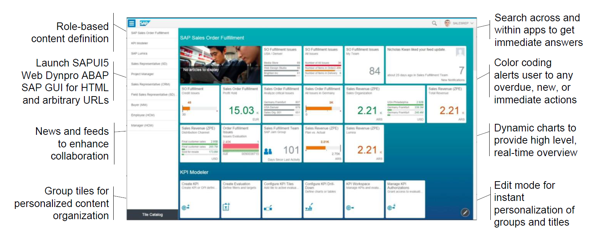
SAP Fiori Launchpad
https://fiorilaunchpad-b6b680212.dispatcher.us1.hana.ondemand.com/sites?sap-client=001

Slide 11
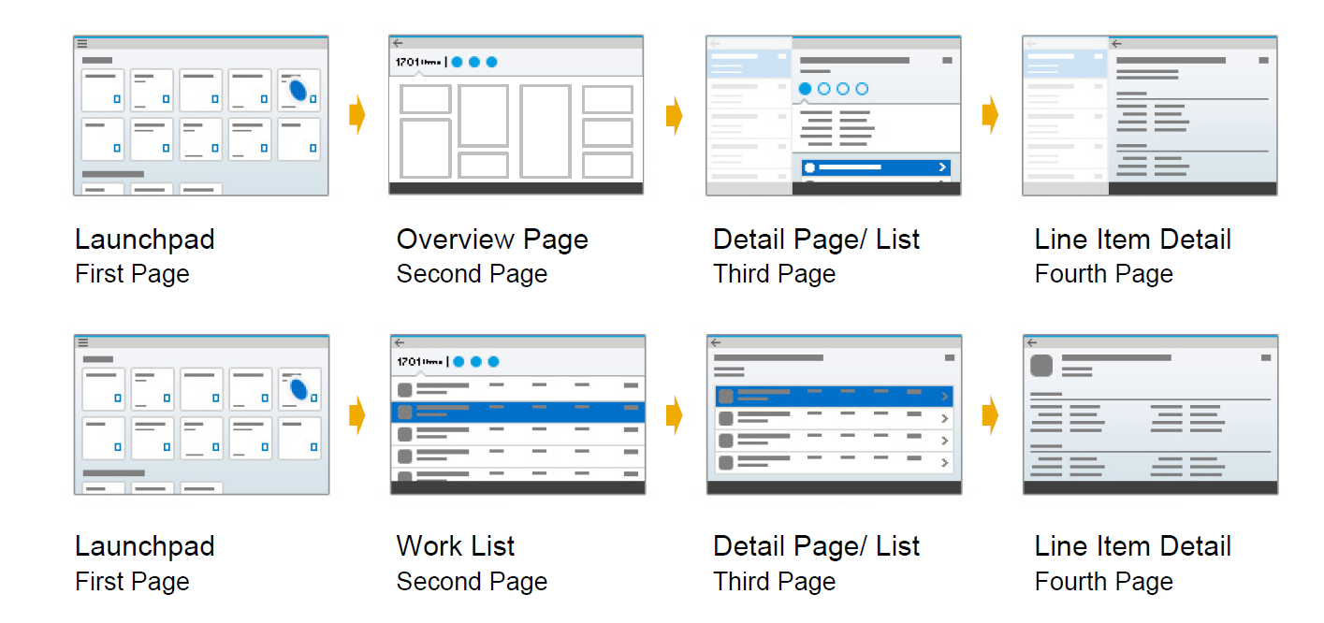
Principle: 1-1-3
One application to accomplish one task in three steps

Slide 12
Design

Slide 13
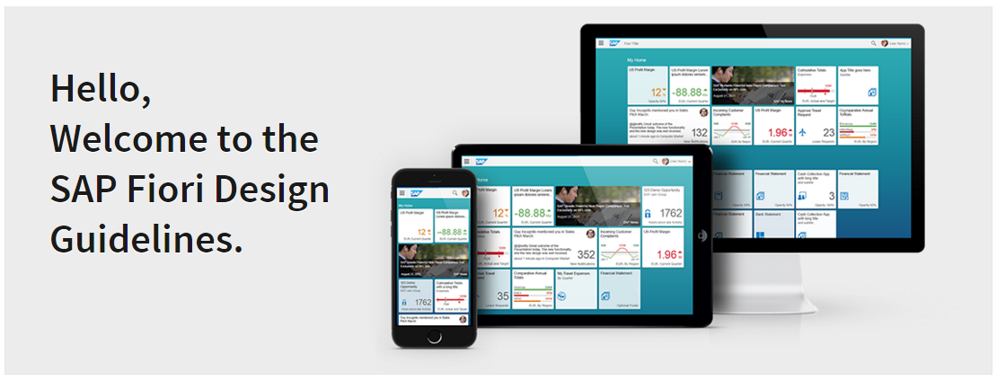
Consistent UX

Slide 14
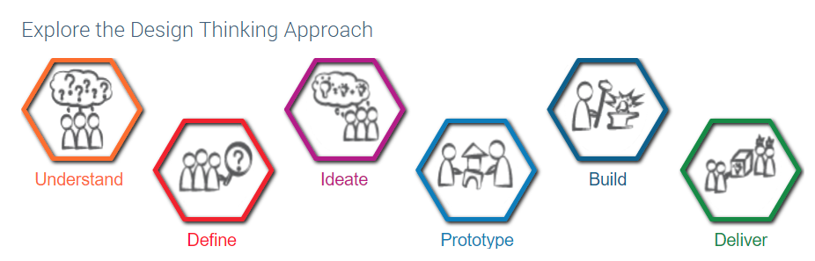
Design Thinking

Slide 15
Technology

Slide 16
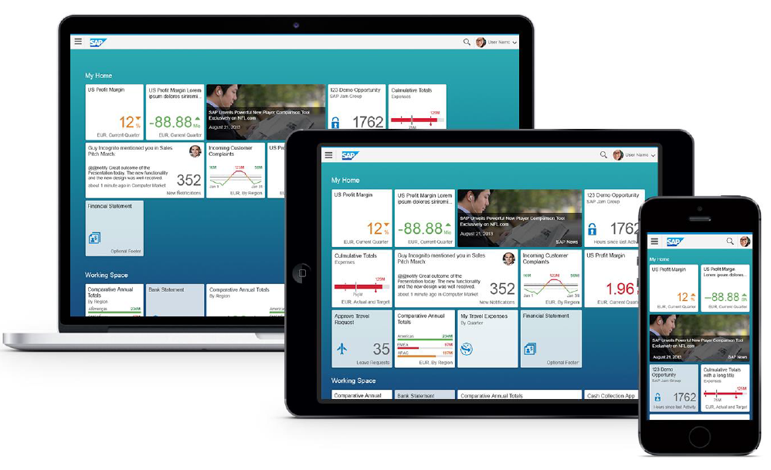
SAPUI5
SAPUI5 is a framework based on JavaSript/HTML5 that is the basis for much of SAP’s UX strategy

Slide 17
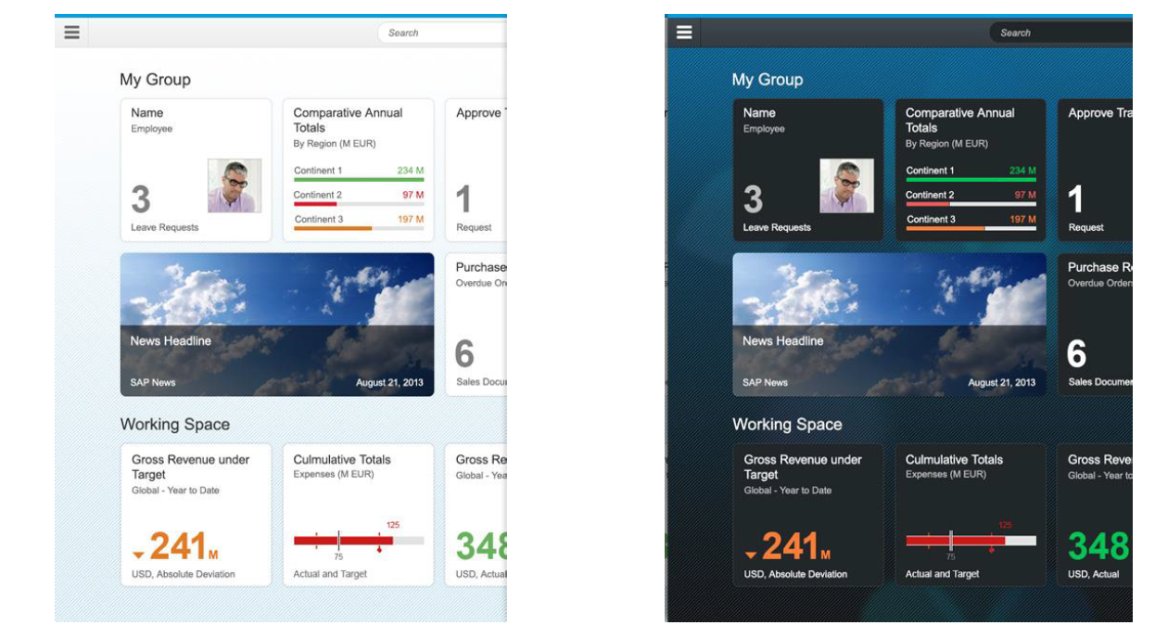
SAPUI5 is Customizable

Slide 18
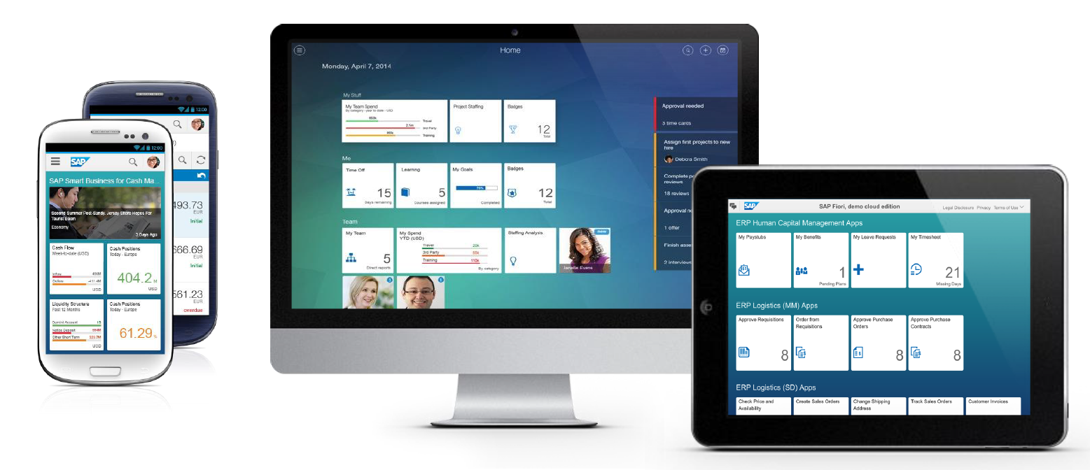
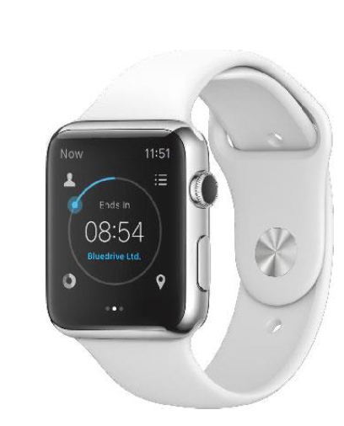
SAPUI5 is Responsive

Slide 19
Thank you
Contact information:
F name MI. L name
Title
Address
Phone number

Slide 21
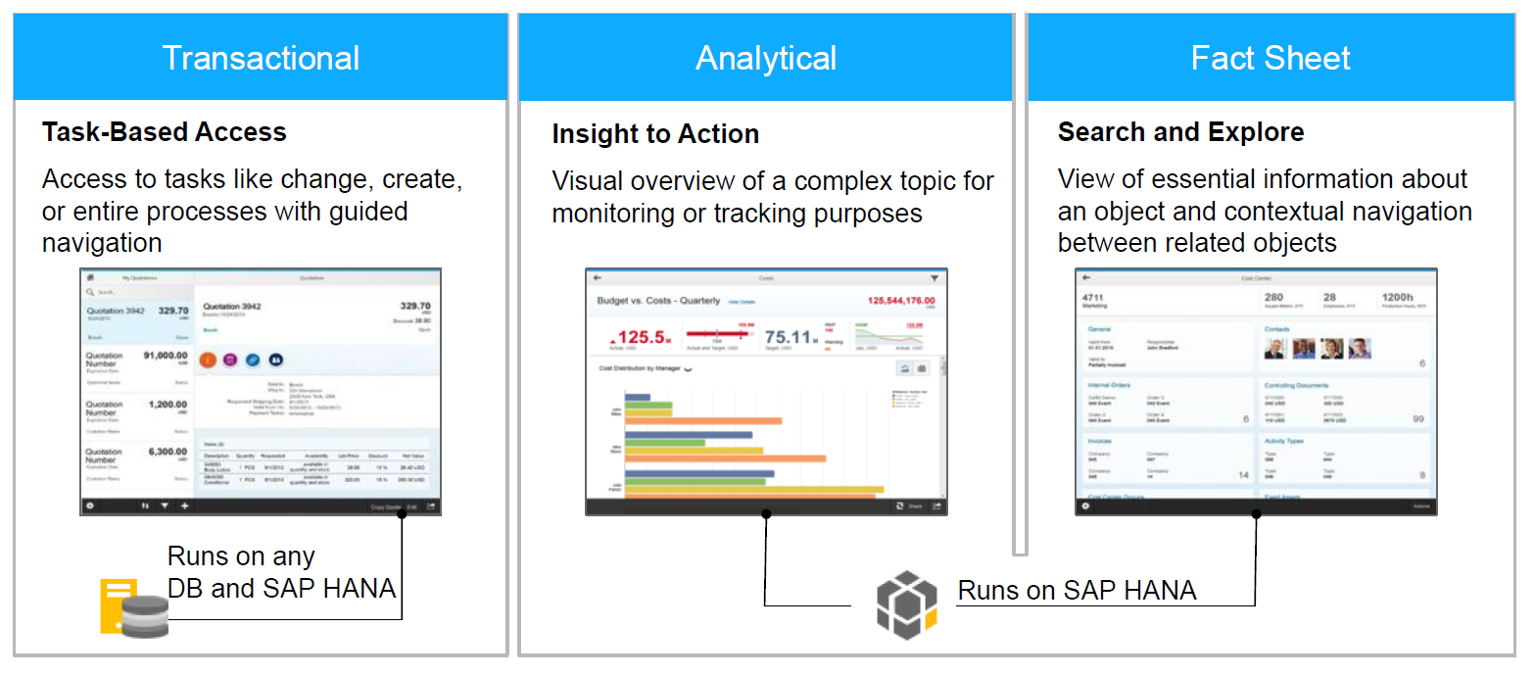
Types of Fiori Applications

